Slide 1
Modeling Project:
Aneurysm Clip
Deliverable 3
Prince Mundy, Brian Ngo, Omid Ghofrani, Isaac Hoyt

Slide 2
Project goal: Model Aneurysm Clip-Artery Interaction
Simulate how different aneurysm clip placements affect the stress distribution on the vessel and aneurysm wall, in order to identify configurations with low rupture risk and high occlusion reliability.
Focus Areas
Effect of clip placement
Stress distribution and occlusion reliability
Clinical Relevance
Improve patient safety by identifying the safest effective clip placement

Slide 3
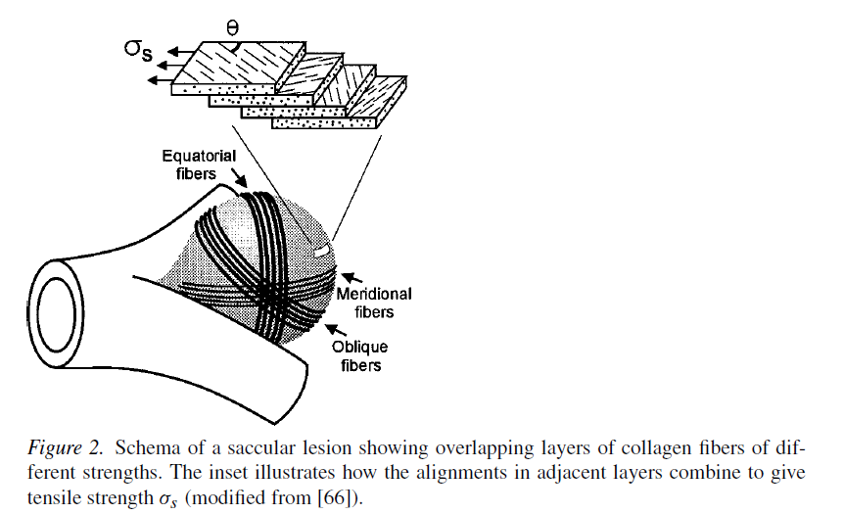
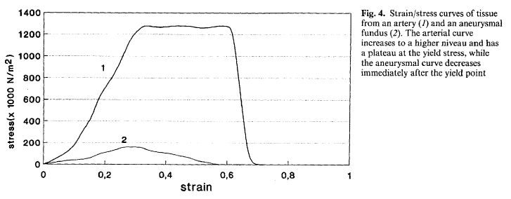
Mechanical Properties of Brain Aneurysms
Poisson’s ratio (ν): ~0.45–0.49 (near-incompressible soft tissue assumption) [1]
Material modeled as nonlinear, anisotropic membrane
Shear modulus (μ):
Yield stress: ~0.50 ± 0.26 MPa
Stretch at rupture (λ): ~1.23–1.37
Elastic modulus: ~1.7 MPa
Neck: [2]
Yield stress: ~1.21 ± 0.49 MPa
Stretch at rupture (λ): ~1.55–1.57
Elastic modulus: ~3.1 MPa
Wall thickness: ~30–500 μm; scales with radius (~2.4%)
[1]
[2]
Notes:
Brian slides

Slide 4
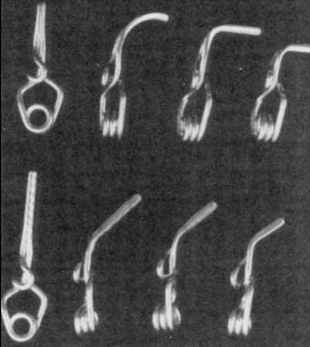
MP35N / Elgiloy: Clip Material Properties
Chosen for biocompatibility and MRI compatibility [3]
Linear elastic metallic materials:
Young’s Modulus: ~210–230 GPa
Yield Strength: ~1100–1400 MPa
Density: ~8300–8400 kg/m³
Non-ferromagnetic: Safe for MRI follow-up imaging
Figure: Variety of clips with different size and shape configurations [3]
Titanium and Cobalt Alloy

Slide 5
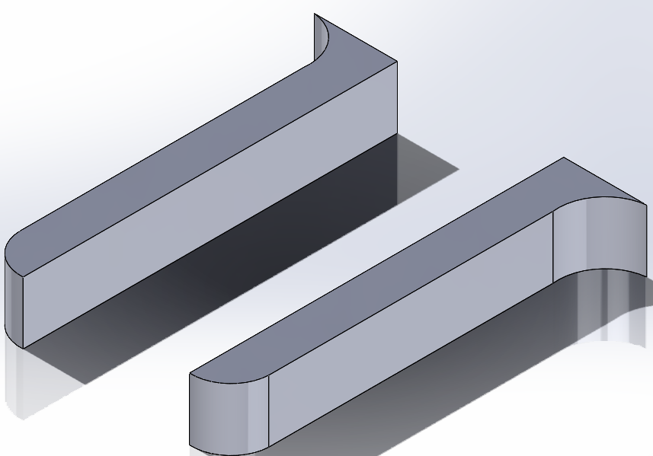
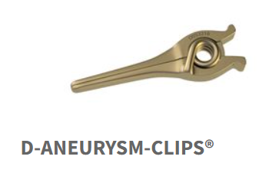
D-Clip (Peter Lazic)
Why D-clip?
Standard clip for broad neck aneurysms.
Stainless steel
Jaw Length: 9 mm
Maximum Opening: 8.9 mm
Closing Force: 0.88 N
Modeling
Closing force and jaw surface areas will be applied as boundary conditions in Ansys
https://www.lazic.de/en/competence/

Slide 6
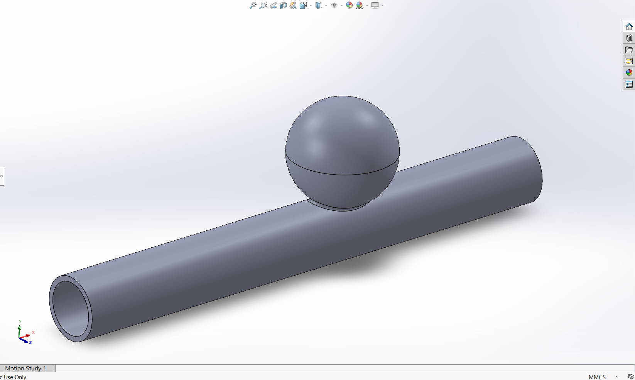
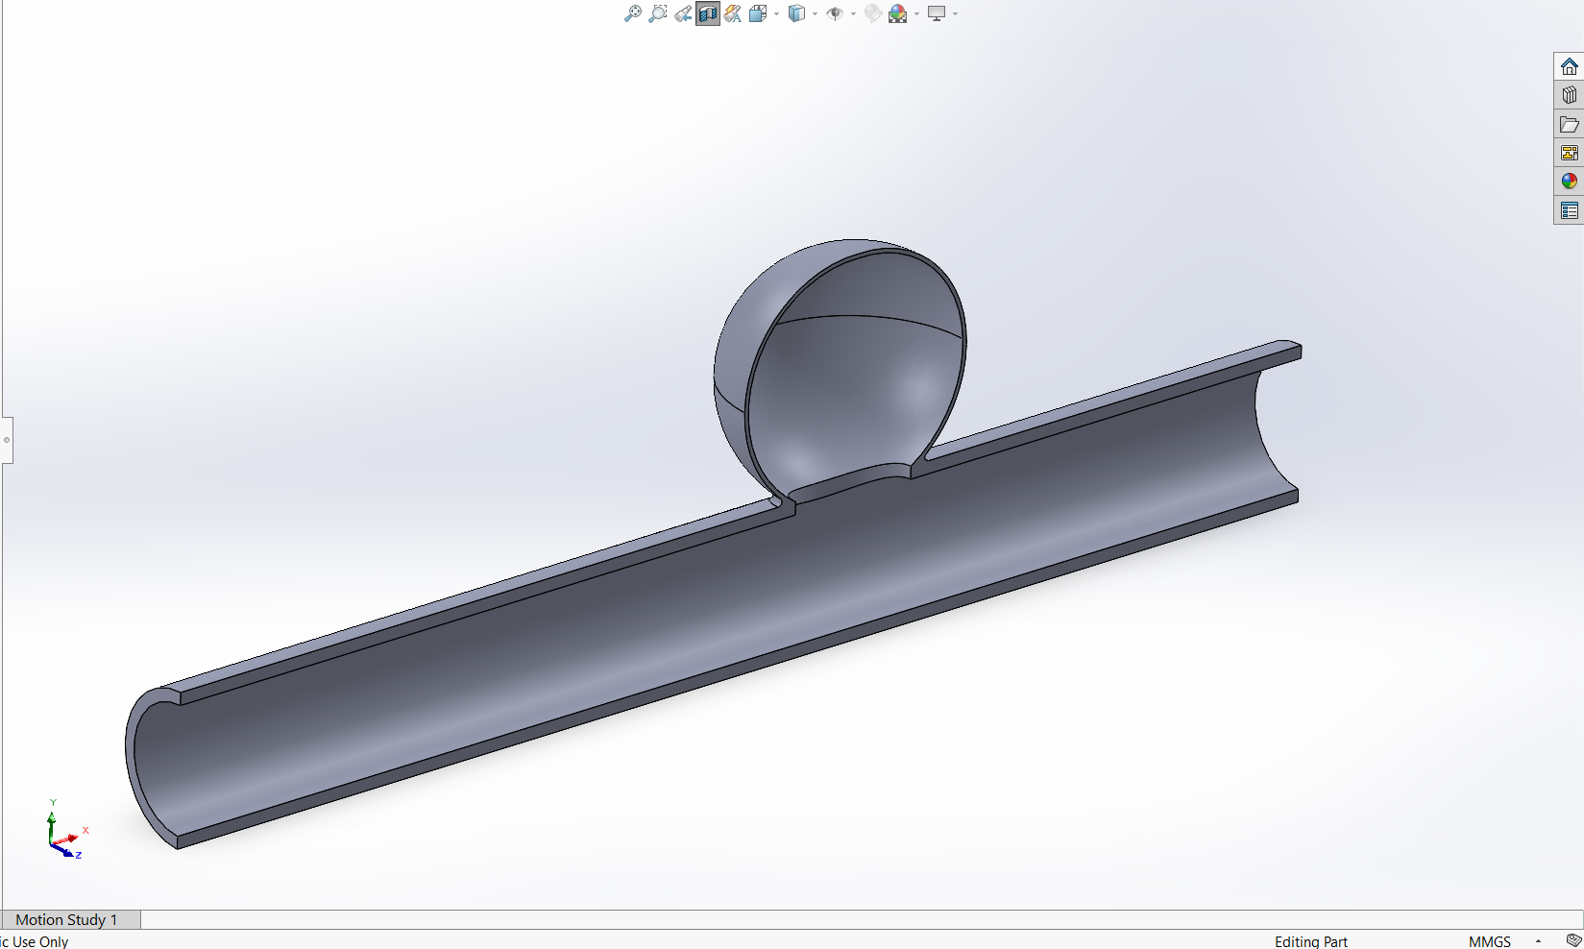
Saccular aneurysm CAD
H
D
N
Model based on simple-lobed (spherical)
Small aneurysm (dome height < 12 mm), H = 5.58 mm
Mean ratios: D/H = 1.11, D/N = 1.91, and H/N = 1.86 [4]
[4] L. Parlea, R. Fahrig, D. W. Holdsworth, and S. P. Lownie, “An Analysis of the Geometry of Saccular Intracranial Aneurysms,” AJNR: American Journal of Neuroradiology, vol. 20, no. 6, p. 1079, Jun. 1999, Available: https://pmc.ncbi.nlm.nih.gov/articles/PMC7056259/#F1.

Slide 7
Methods
Instead of a full bloodflow CFD, we will apply an internal pressure of 13 mmHg to the artery walls, equivalent to the normal intracranial pressure of a supine adult
Apply symmetry boundary condition along the middle of the artery
Apply Peter Lazic D-Clip with .88 N of force at several positions

Slide 8
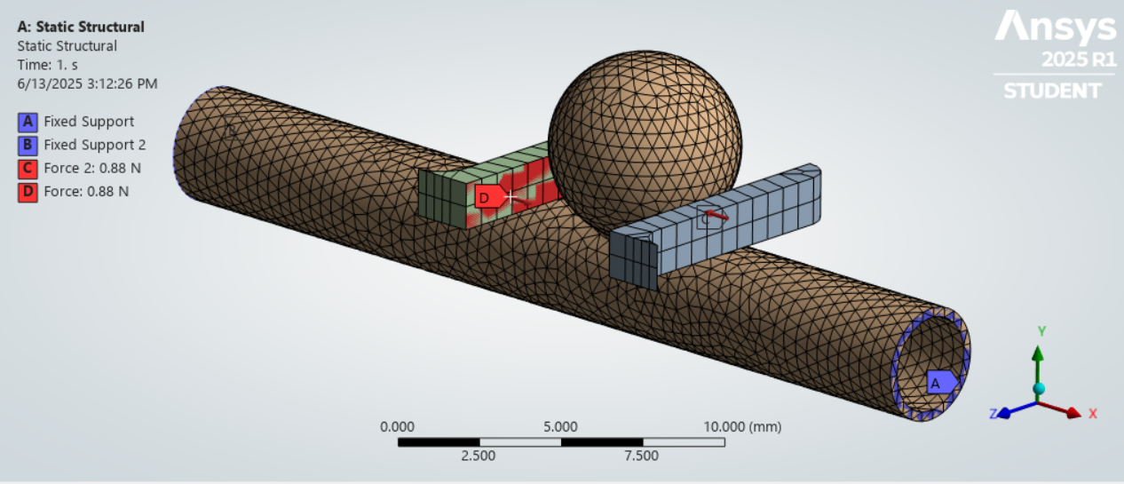
Results
Mesh:
Body (artery + vessel) = 0.5mm

Slide 9
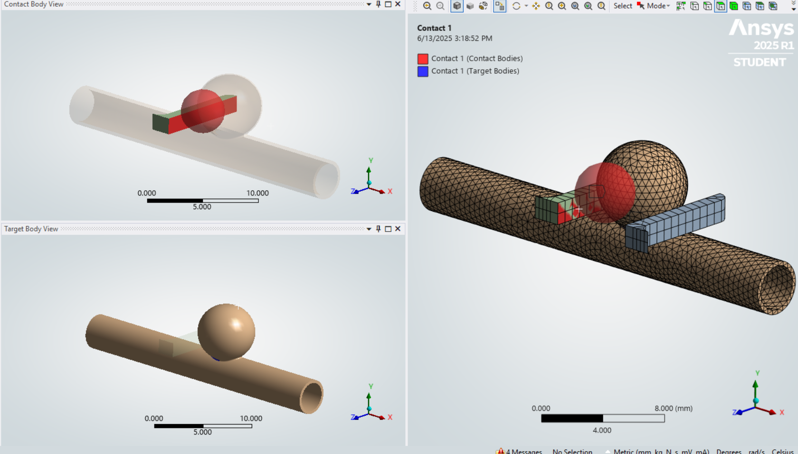
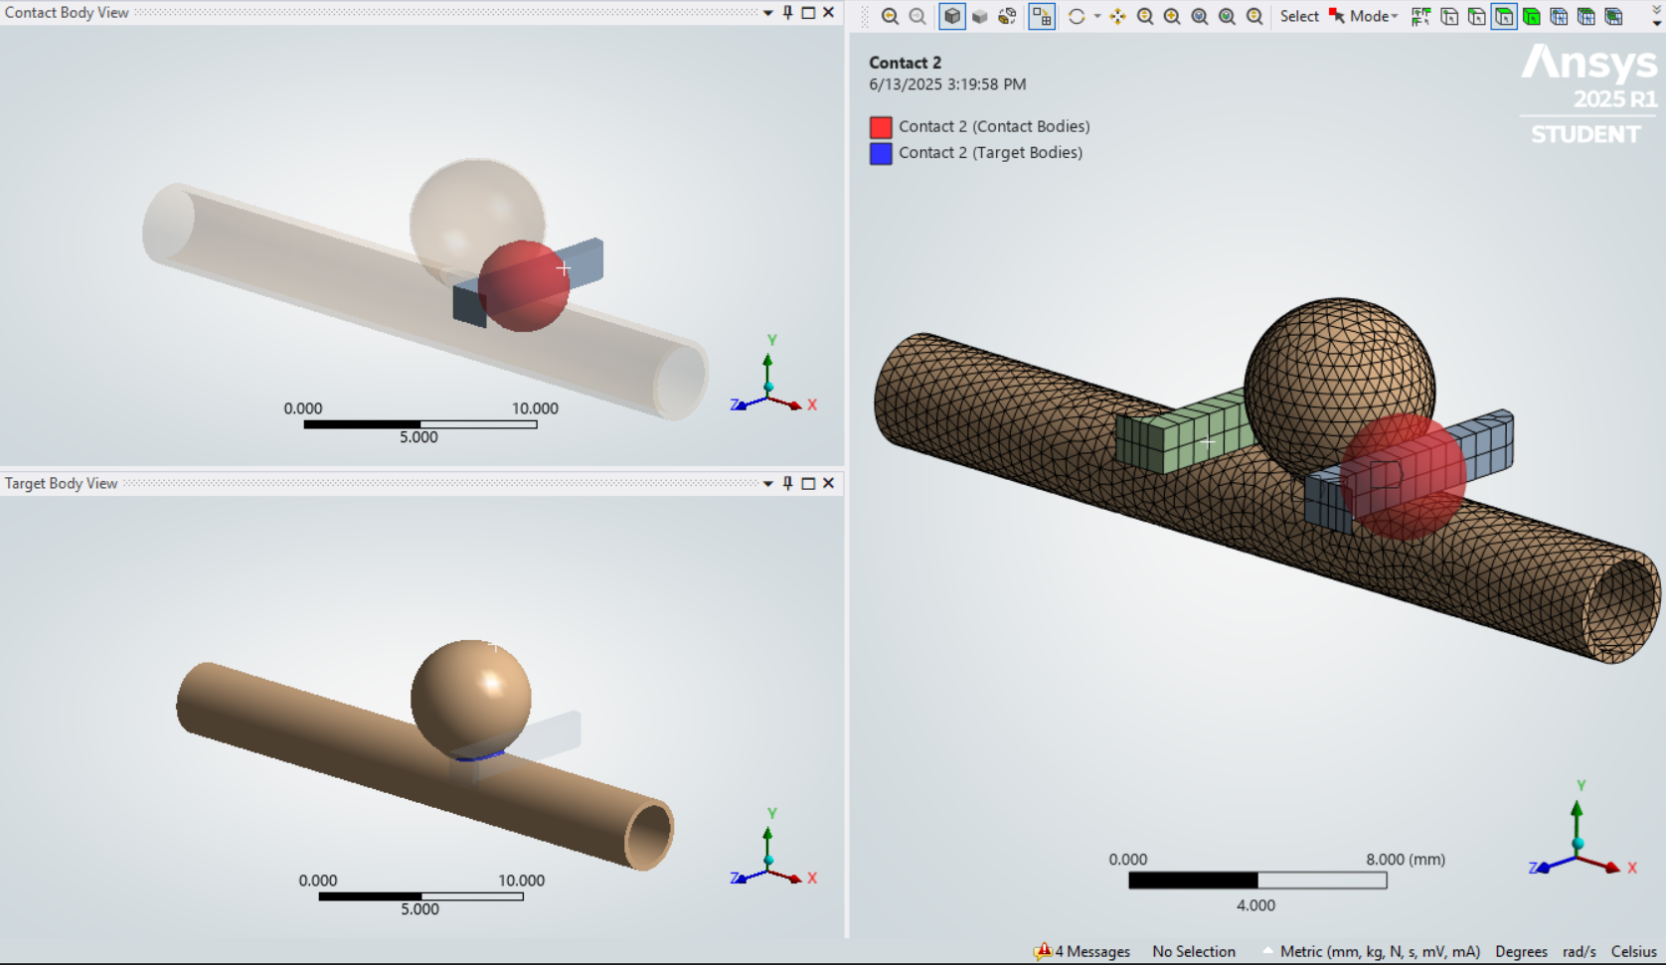
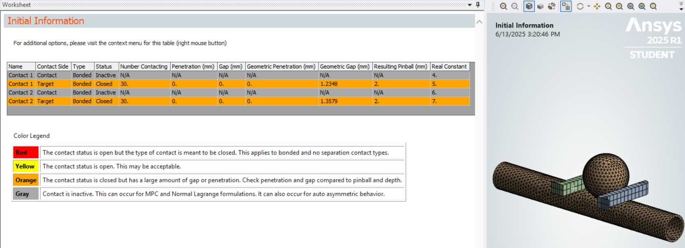
Contact Modeling

Slide 10
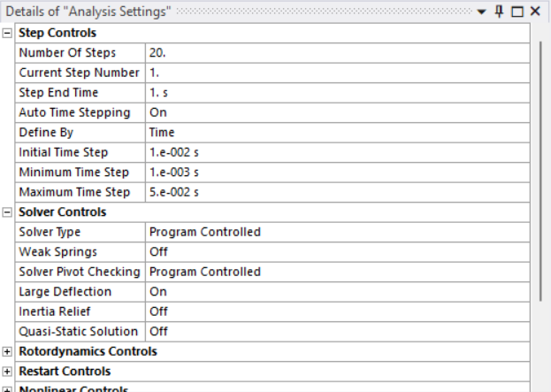
Analysis Settings

Slide 11
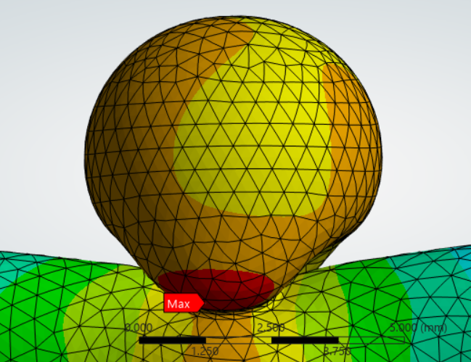
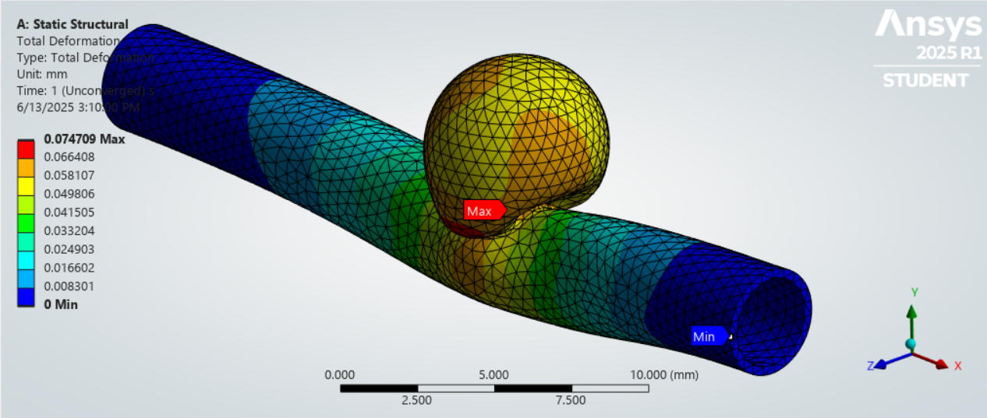
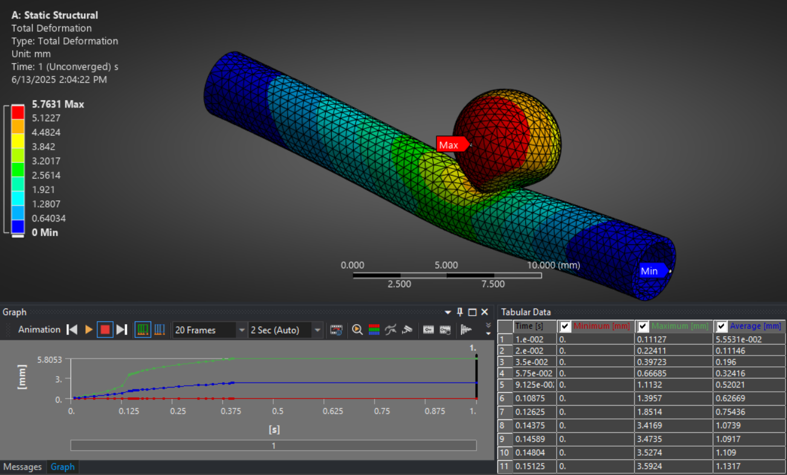
Total Deformation at Neck
Results

Slide 12
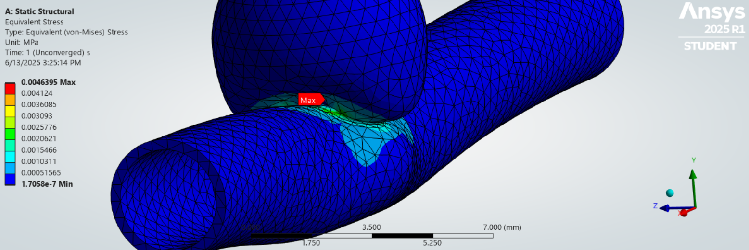
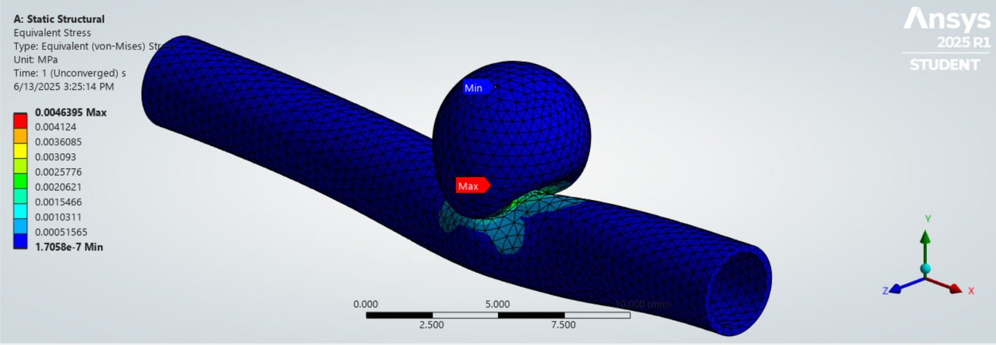
Equivalent Stress at Neck

Slide 13
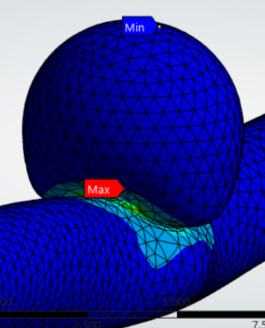
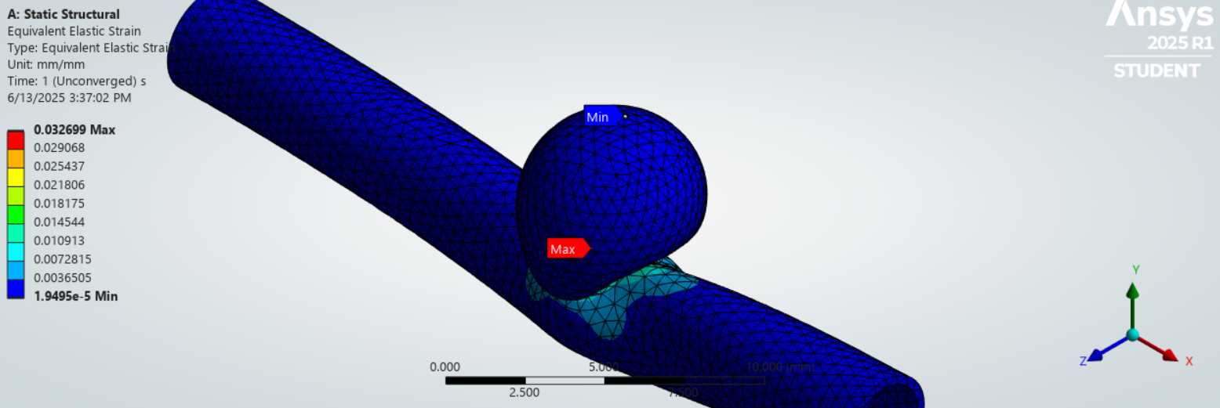
Equivalent Strain at Neck

Slide 14
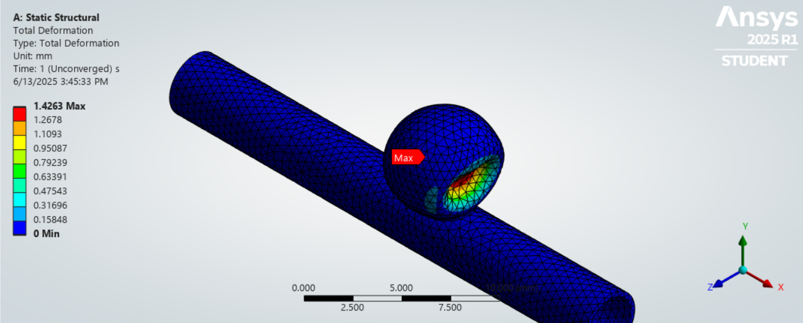
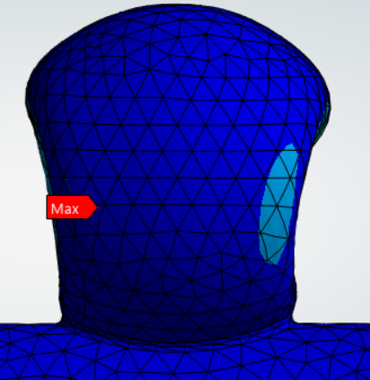
Total Deformation w/ Higher Placed Clip
Results

Slide 15
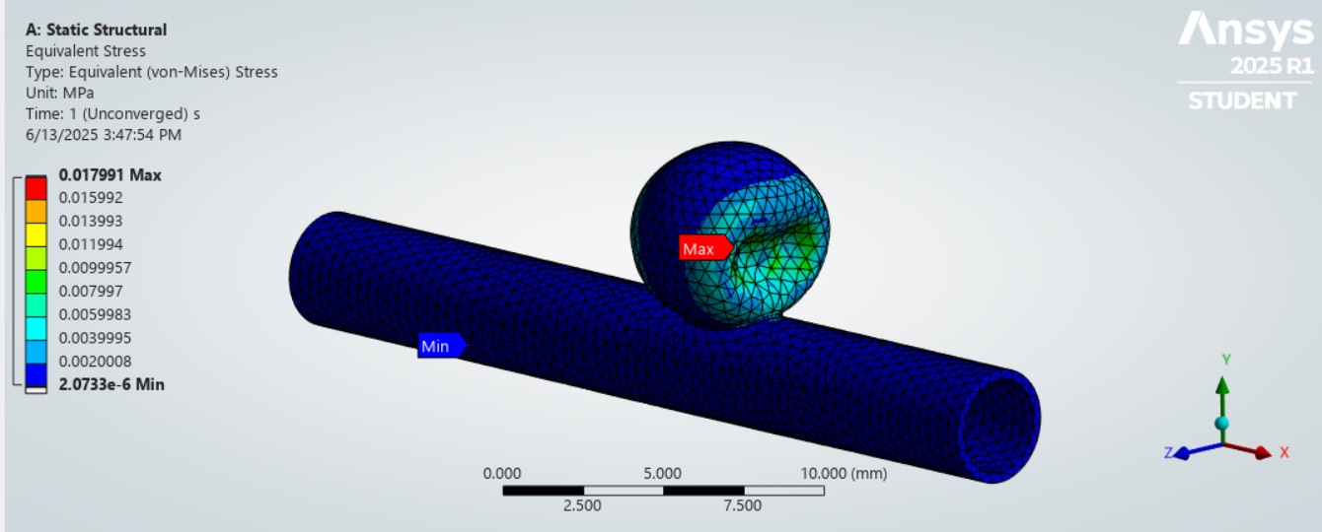
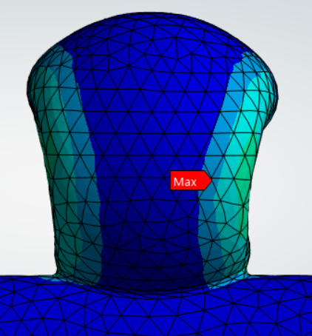
Equivalent Stress w/ Higher Placed Clip

Slide 16
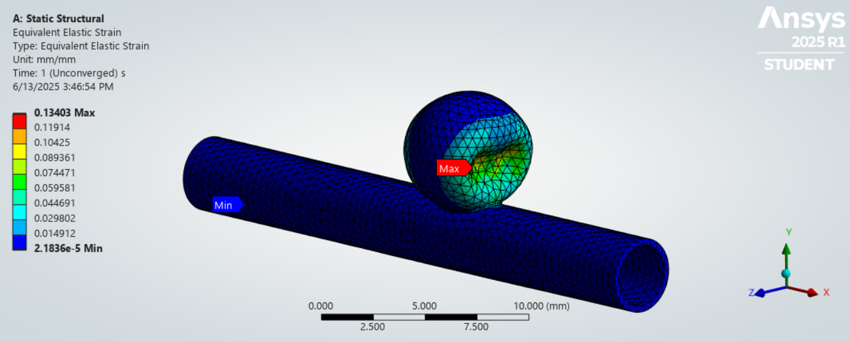
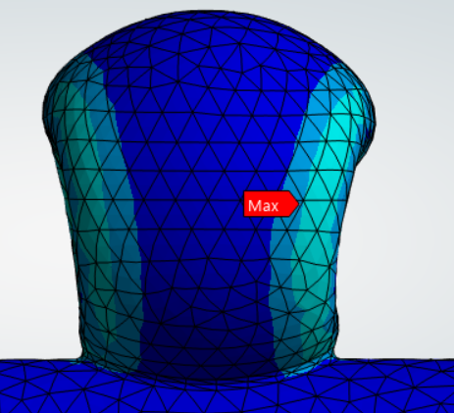
Equivalent Strain w/ Higher Placed Clip

Slide 17
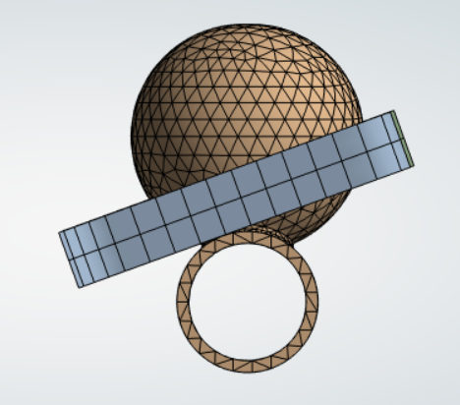
Equivalent Strain w/ 20º Angle
20º

Slide 18
Total Deformation w/ 20º Angle
Results

Slide 19
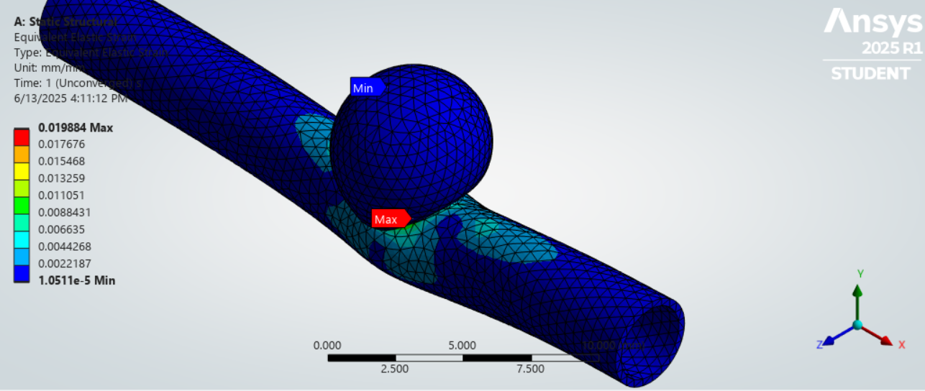
Equivalent Stress w/ 20º Angle

Slide 20
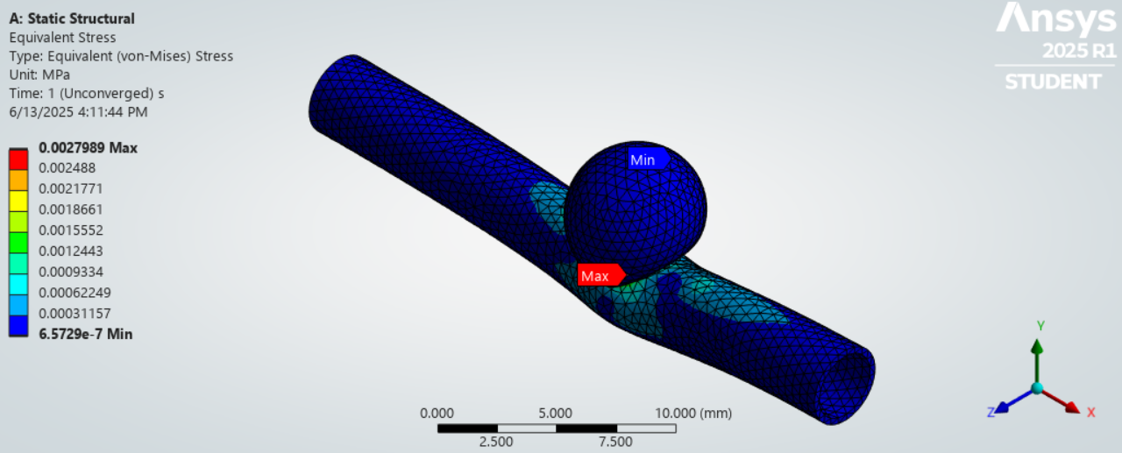
Equivalent Strain w/ 20º Angle

Slide 21
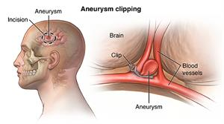
Discussion
Optimal clip placement is at the neck of the aneurysm.
Dome placements fail to fully occlude blood flow, leaving residual pressure inside.
A 20° angled clip at the neck showed minimal strain and effective sealing.
Direct neck placement achieves the most complete occlusion, reducing rupture risk.
Results support clinical findings that precise neck clipping is essential for successful treatment.
Notes:
Our simulation results indicate that the optimal placement for the aneurysm clip is at the neck of the aneurysm.
As shown in our second set of diagrams, clips placed higher on the dome fail to fully occlude blood flow, leaving residual pressure inside the aneurysm.
When simulating a 20° angled clip placement at the neck, we observed minimal strain concentrations and effective sealing, reinforcing that angled approaches can still be effective if targeted precisely.
In contrast, clip placement directly on the neck achieves the most complete occlusion, minimizing the risk of continued perfusion or rupture.
These findings support clinical observations that precise neck clipping is critical for successful aneurysm treatment.

Slide 22
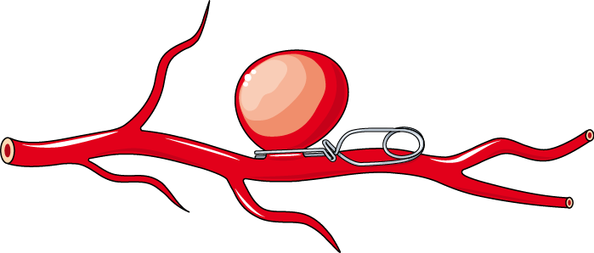
Discussion
How Do the Results Address the Critical Need?
Neck placement = best occlusion
Dome placement = incomplete sealing
Supports clinical practice
FEM guides safer clip use
Notes:
🧠 How Do the Results Address the Critical Need?
The critical need was to determine the safest and most effective placement for aneurysm clips to minimize rupture risk and ensure full occlusion.
Simulation results showed that placing the clip directly at the neck leads to maximum occlusion and minimal residual strain.
Higher placements on the aneurysm dome resulted in incomplete occlusion, supporting the importance of neck placement for effective treatment.
These findings align with clinical practice and highlight how finite element modeling can guide safer clip positioning.

Slide 23
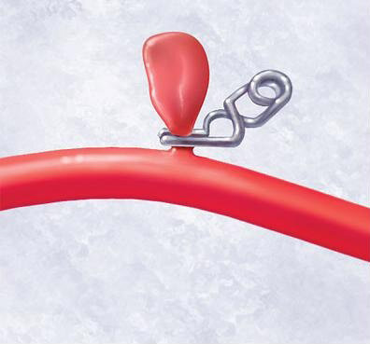
Discussion
Strengths
Realistic artery material
Multiple clip scenarios (e.g., 20°)
Real clip specs used
Clear stress/strain visuals
Limitations
Idealized aneurysm shape
Static pressure only
No blood flow modeling
Simplified clip contact
Notes:
💪 Strengths
Realistic mechanical modeling of aneurysm tissue using hyperelastic and anisotropic properties.
Simulation of surgical scenarios, including different clip positions and angles like 20 degrees, provides insight into mechanical performance.
Use of actual clinical clip specs (D-Clip force, geometry) improves translational relevance.
Clear visual results (stress, strain, deformation) help identify the safest effective clip placements.
⚠️ Limitations
Idealized aneurysm geometry (spherical shape) may not capture complex patient-specific anatomy.
Simplified internal loading (static pressure only) does not account for dynamic blood flow or pulsatility.
No direct simulation of blood perfusion or post-clip flow, limiting physiological accuracy.
Physical clip-tissue contact interaction was approximated using pressure loads rather than full friction/contact models.

Slide 24
Works Cited
[1] L. Parlea, R. Fahrig, D. W. Holdsworth, and S. P. Lownie, “An Analysis of the Geometry of Saccular Intracranial Aneurysms,” AJNR: American Journal of Neuroradiology, vol. 20, no. 6, p. 1079, Jun. 1999, Available: https://pmc.ncbi.nlm.nih.gov/articles/PMC7056259/#F1.
[2] Hans Jakob Steiger, Rune Aaslid, S. Keller, and H. J. Reulen, “Strength, elasticity and viscoelastic properties of cerebral aneurysms,” Heart and Vessels, vol. 5, no. 1, pp. 41–46, Mar. 1989, doi: https://doi.org/10.1007/bf02058357

Slide 25
THANKS!
DO YOU HAVE ANY QUESTIONS?

